Slide 1
ZAS Academy
Python Curriculum for IOT & AI

Slide 2
Day7 - Agenda
Day 6 – Recap: File IO & Networking
How Internet Works/Cloud At Home
What is Cloud Computing
AWS EC2 Instance Setup
FTP Client Setup
Login to AWS EC2
Transferring files to/from EC2
Python Flask

Slide 3
Known & Useful Functions:
len – to find the length of array or string
range(5) – starts i from 0 to 4 (doesn’t include 5) in increments of 1
range(2, 5) – starts i from 2 to 4 (doesn’t include 5) in increments of 1
range(3, 10, 2) – starts i from 3 to 9 (doesn’t include 10) in increments of 2
append(2) – to add an element to the array
list() – list data type
sort() – on numeric types
sorted() - anagram
% - modulus operator or division

Slide 4
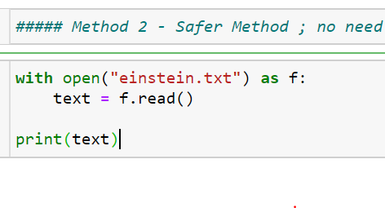
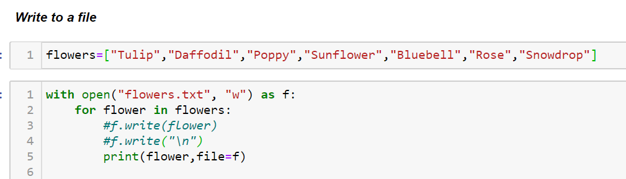
Python IO

Slide 5
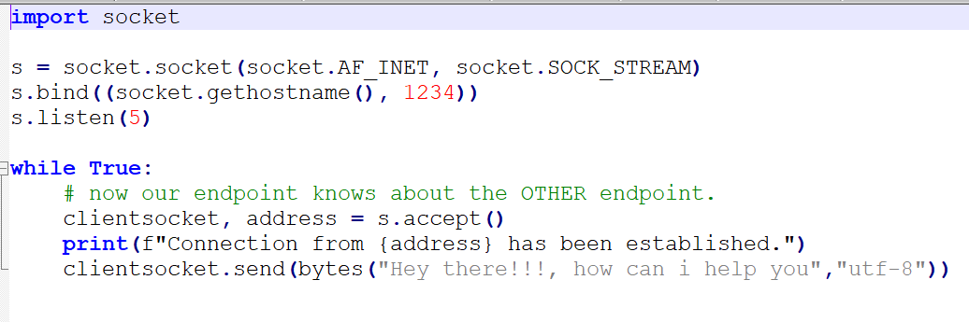
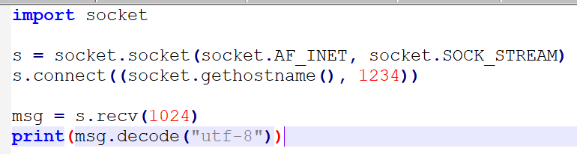
Python Networking
Server.py
Client

Slide 6
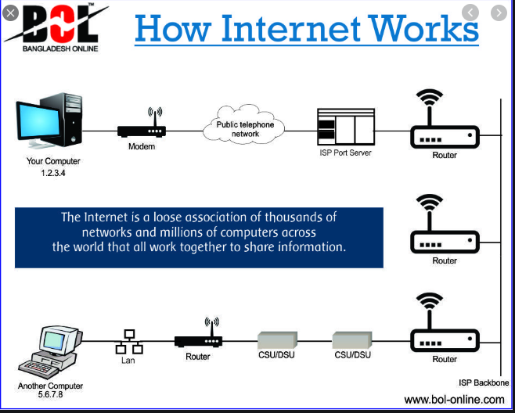
Cloud Computing at Home

Slide 7
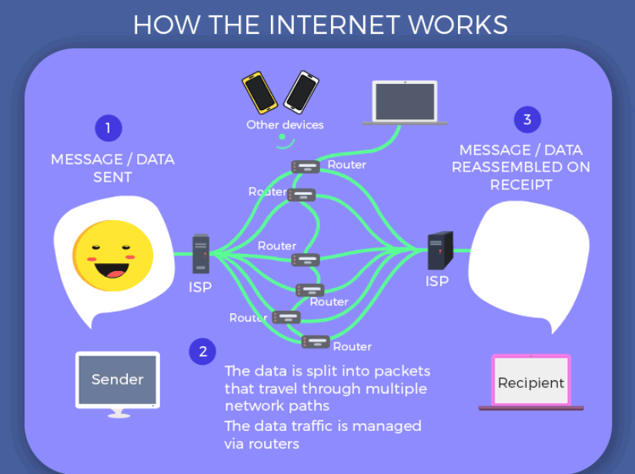
Cloud Computing at Home

Slide 8
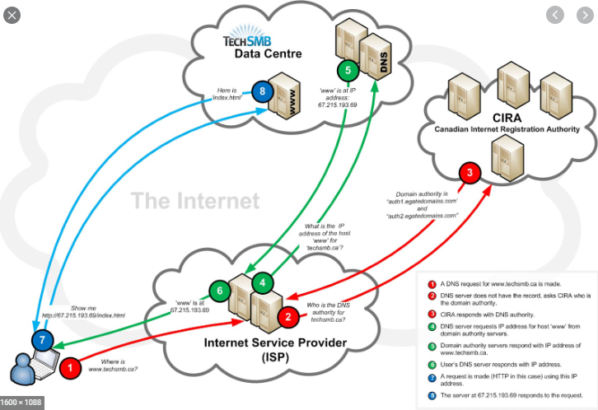
Cloud Computing at Home

Slide 9
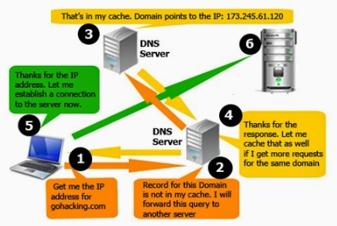
Cloud Computing at Home

Slide 10
Cloud Computing at Home
Acquire a Dedicated PC
Get the OS
Install the OS
Setup VNC
Install FTP
Configure FTP Users
Configure and Activate FTP Server!
Install HTTP Support, Sit Back and Relax
Install a Video Game Server (Optional)
Forward the Ports
Get a Free Domain
Test It Out!
https://www.siteuptime.com/blog/2019/12/19/how-to-create-your-own-server-at-home-for-web-hosting/
https://www.howtogeek.com/362602/can-you-host-a-web-server-on-your-home-internet-connection/
https://www.servermania.com/kb/articles/how-to-quickly-setup-your-own-web-server/

Slide 11


Cloud Computing
Simply put, cloud computing is the delivery of computing services—including servers, storage, databases, networking, software, analytics, and intelligence—over the Internet (“the cloud”) - to offer faster innovation, flexible resources, and economies of scale. You typically pay only for cloud services you use, helping lower your operating costs, run your infrastructure more efficiently and scale as your business needs change. (Microsoft Azure)
https://azure.microsoft.com/en-in/overview/what-is-cloud-computing/
Cloud computing is the on-demand delivery of IT resources over the Internet with pay-as-you-go pricing. Instead of buying, owning, and maintaining physical data centers and servers, you can access technology services, such as computing power, storage, and databases, on an as-needed basis from a cloud provider like Amazon Web Services (AWS).l
https://aws.amazon.com/what-is-cloud-computing/

Slide 12
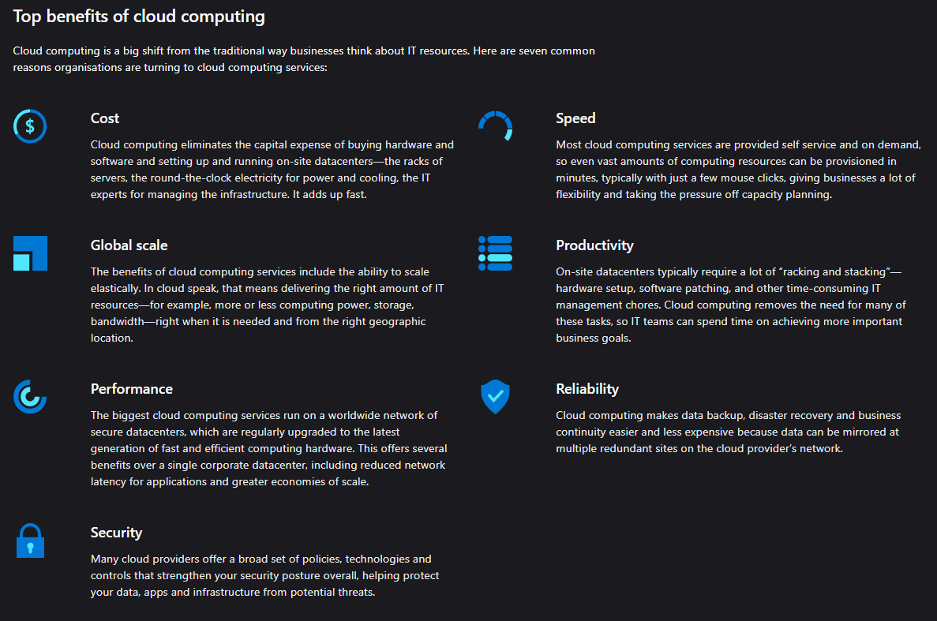
Cloud Computing

Slide 13
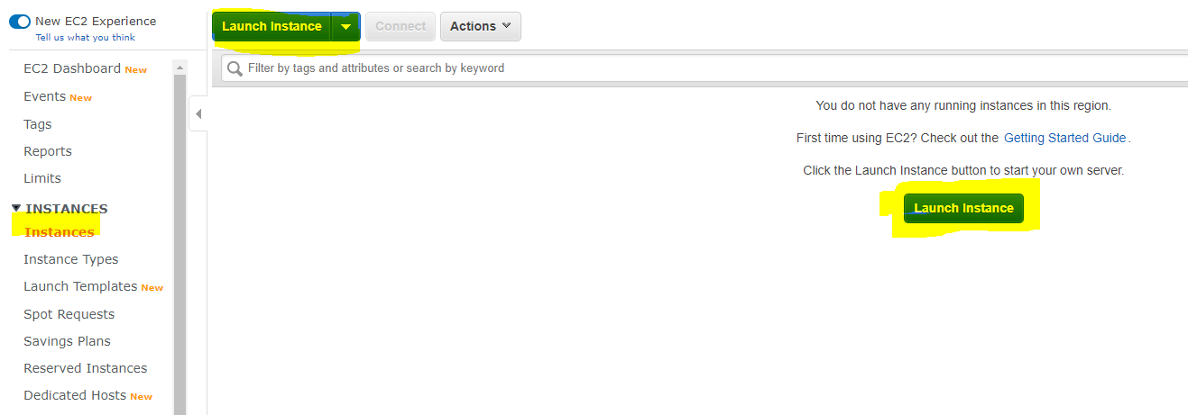
Client/Server - Authentication

Slide 14
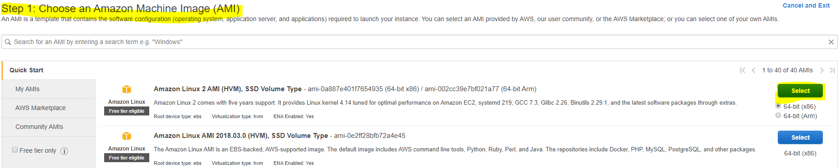
AWS – Launch your EC2 Server Instance

Slide 15
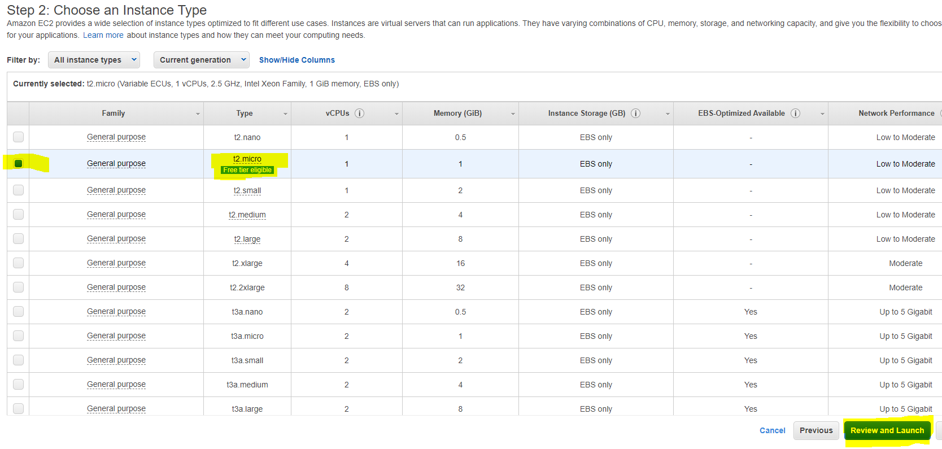
AWS – Launch your EC2 Server Instance

Slide 16
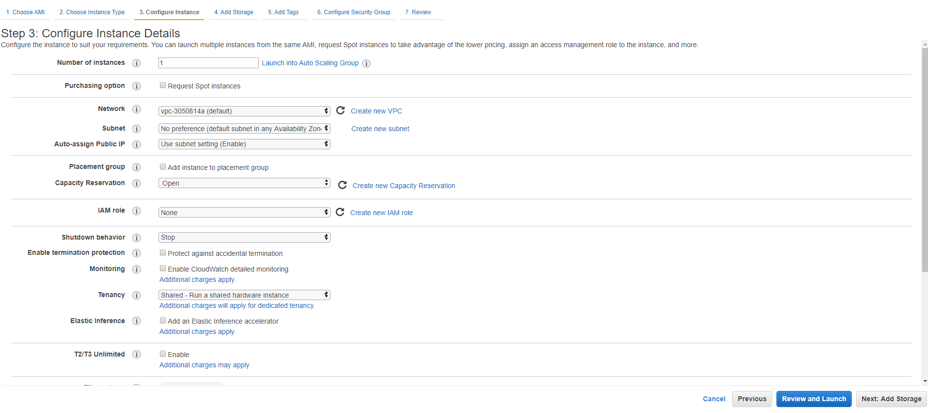
AWS – Launch your EC2 Server Instance

Slide 17
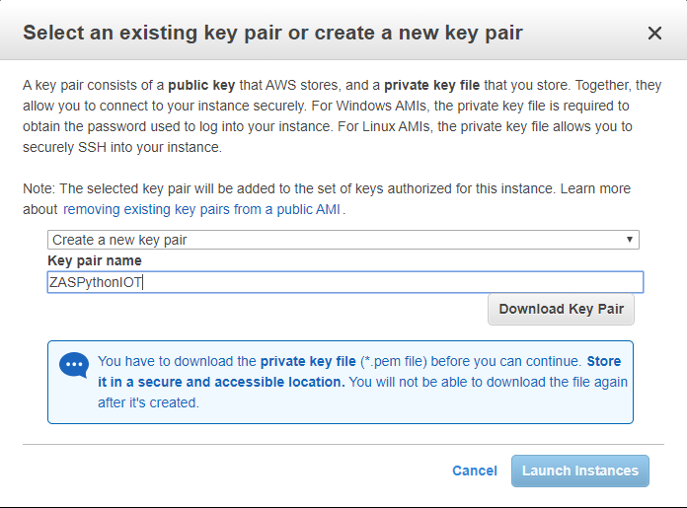
AWS – Launch your EC2 Server Instance

Slide 18
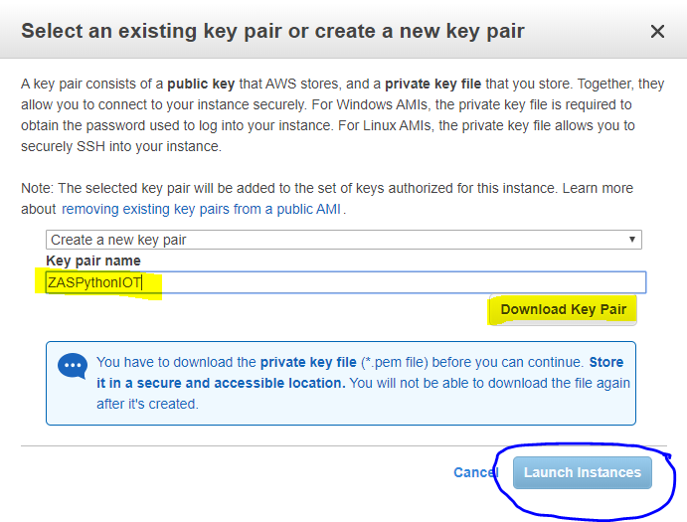
AWS – Launch your EC2 Server Instance
Keep the Private Key - SAFE
1
2

Slide 19
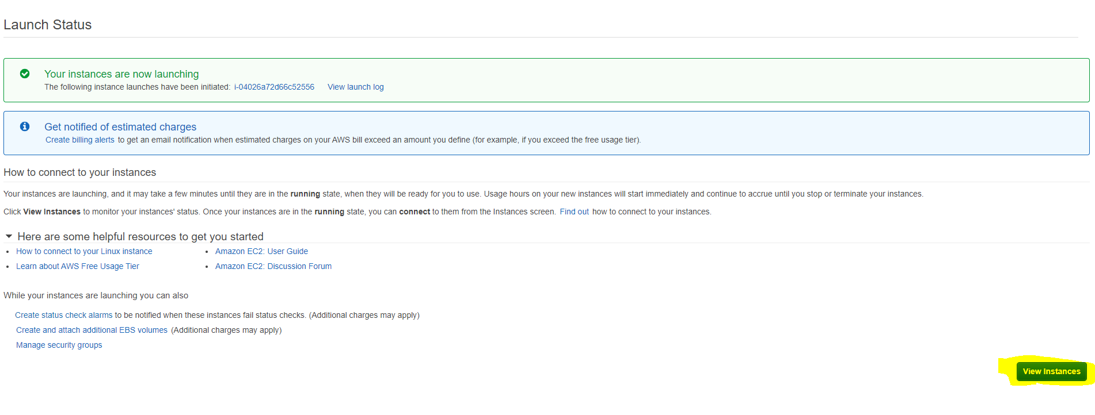
AWS – Launch your EC2 Server Instance

Slide 20
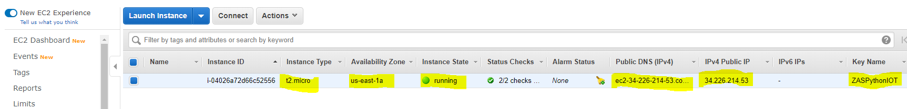
AWS – Launch your EC2 Server Instance

Slide 21
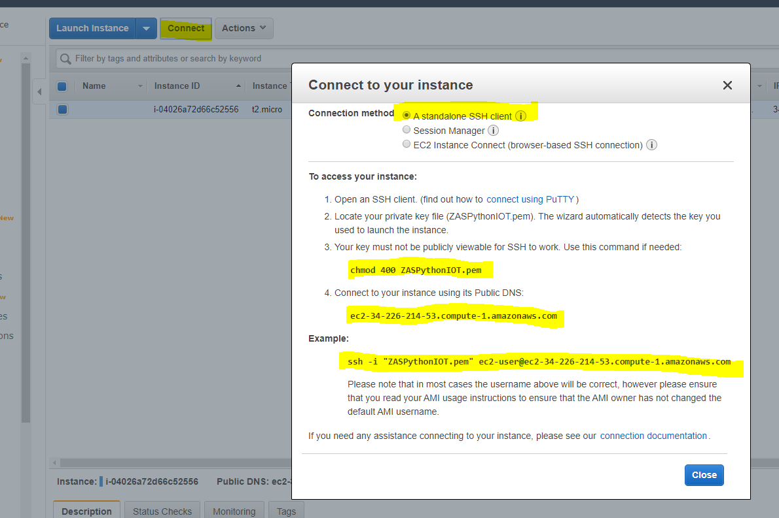
AWS – Launch your EC2 Server Instance
Make a note of these details:
ec2-34-226-214-53.compute-1.amazonaws.com
ssh -i "ZASPythonIOT.pem" ec2-user@ec2-34-226-214-53.compute-1.amazonaws.com
chmod 400 ZASPythonIOT.pem

Slide 22
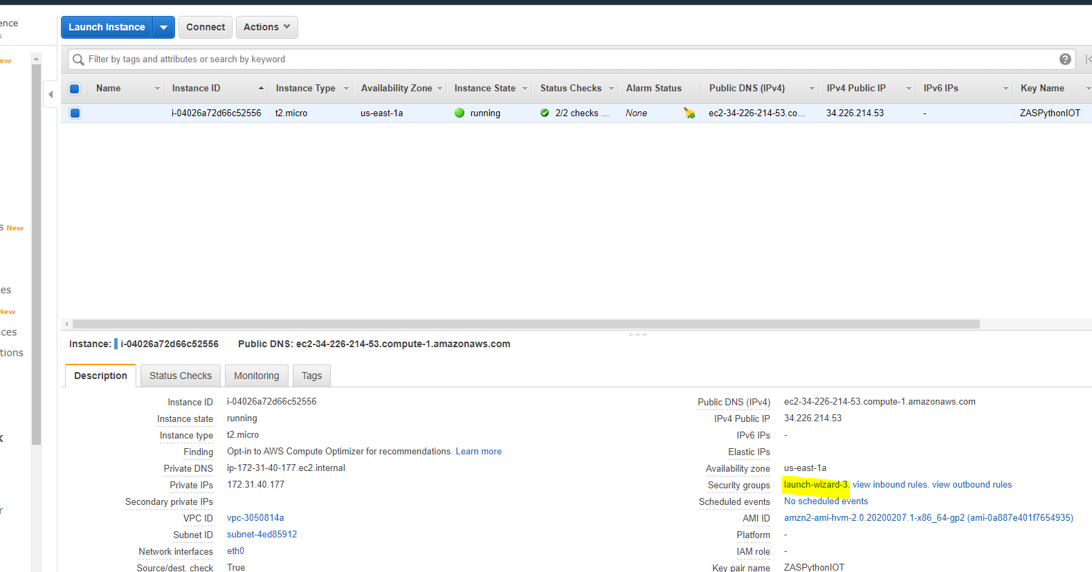
AWS –EC2 Server Instance - Networking
Networking

Slide 23
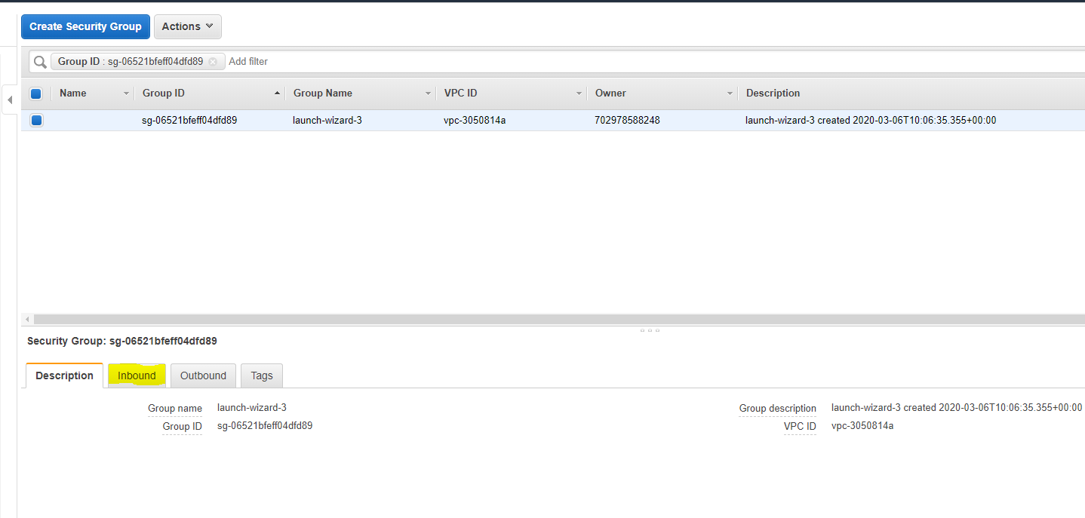
AWS –EC2 Server Instance - Networking
Networking

Slide 24
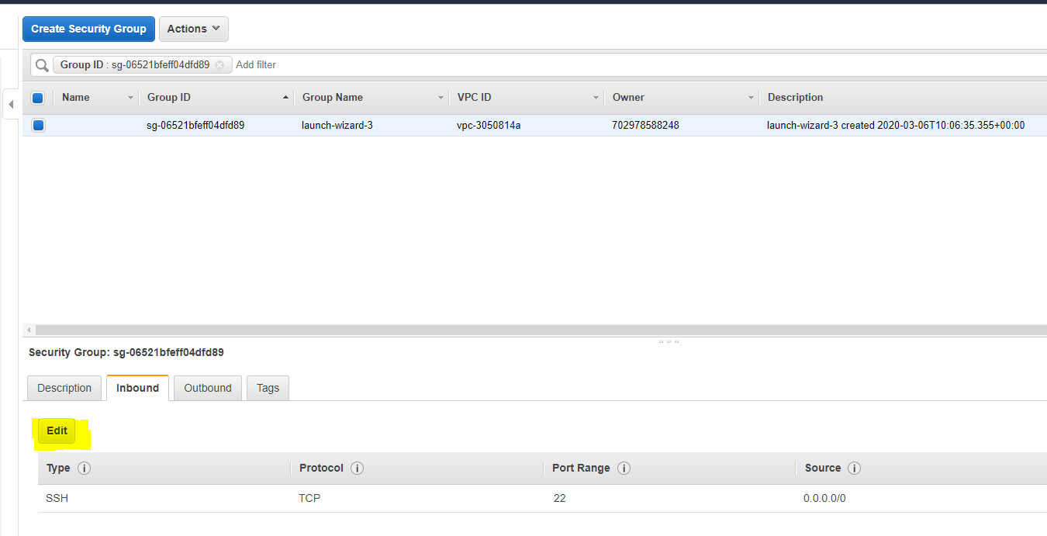
AWS –EC2 Server Instance - Networking

Slide 25
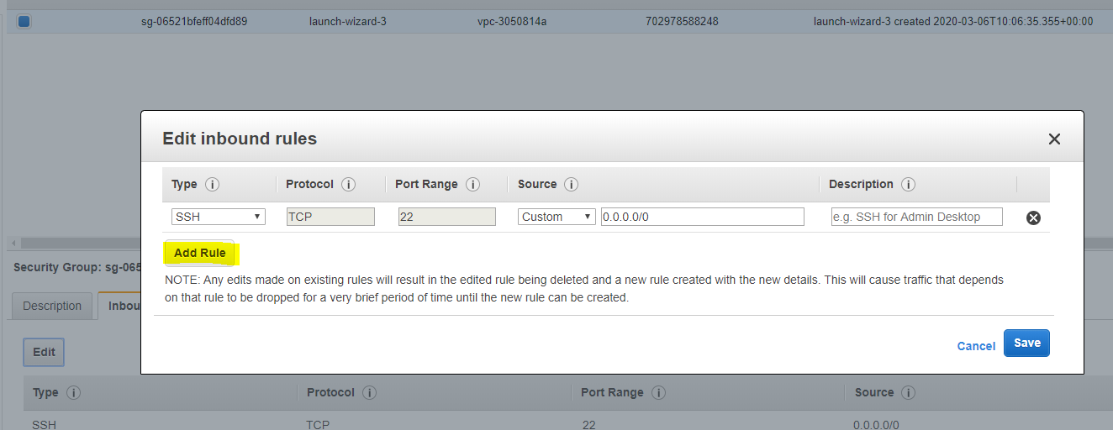
AWS –EC2 Server Instance - Networking

Slide 26
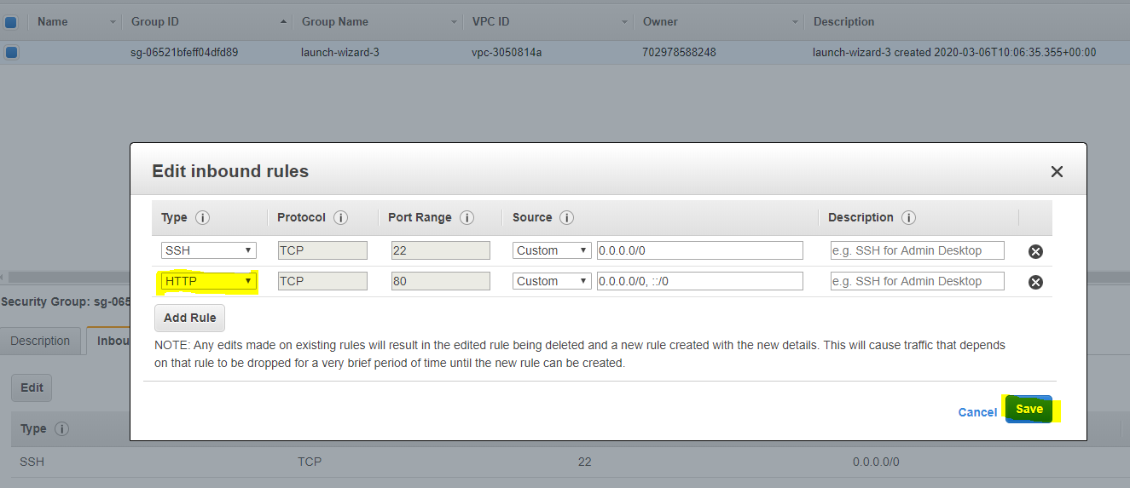
AWS –EC2 Server Instance - Networking

Slide 27
AWS –EC2 Server Instance – Python Installation
sudo yum update -y
sudo yum install python3
sudo pip3 install flask
sudo pip3 install numpy

Slide 28
AWS –EC2 Server Instance – Your First Web Page
from flask import Flask, render_template, request
#### initialize the flask app.
app = Flask(__name__)
################################
# home page
################################
@app.route('/', methods=['GET', 'POST'])
@app.route('/home', methods=['GET', 'POST'])
def home():
return '<h1>Hello World</h1>'

Slide 29
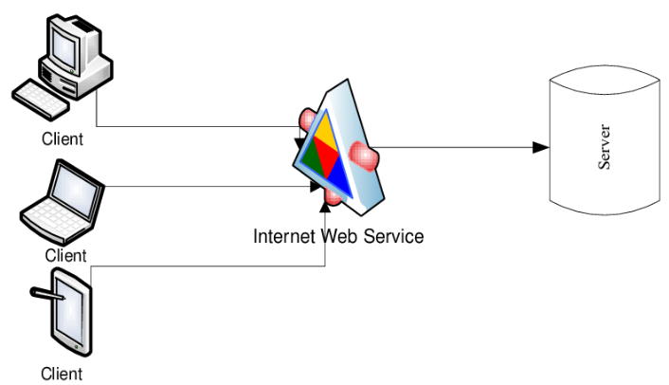
TCP/IP - Client/Server
Server on Cloud – AWS/Azure
Your Laptop
https://filezilla-project.org/download.php?platform=osx

Slide 30
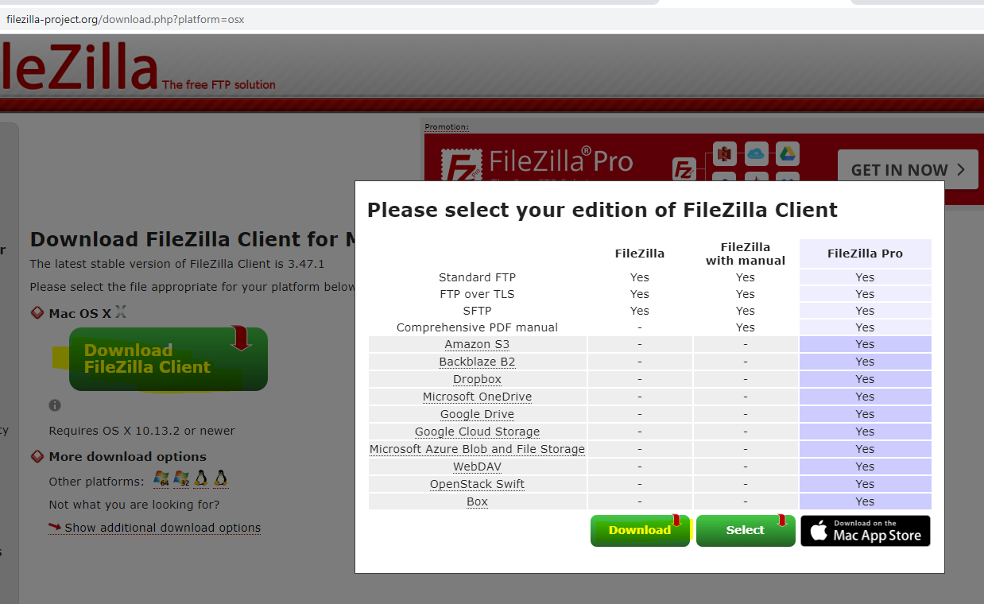
FTP Client Installation
https://filezilla-project.org/download.php?platform=osx

Slide 31
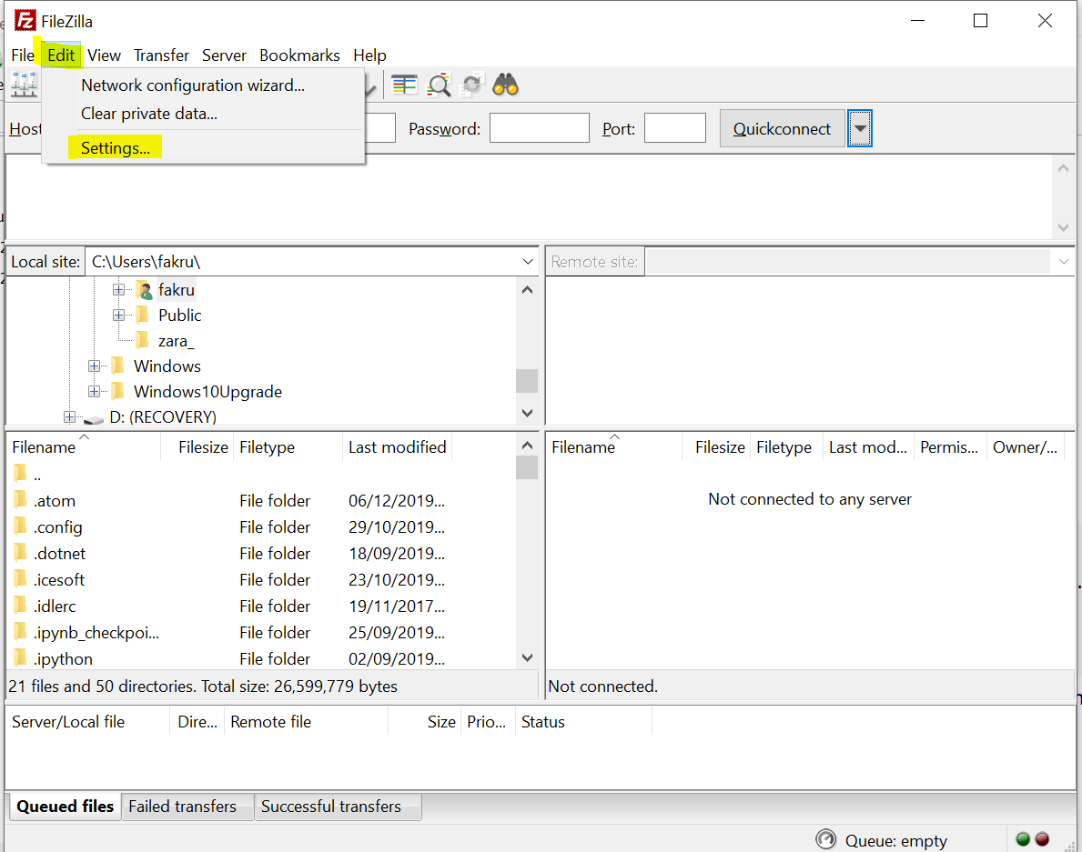
FTP Client Installation
https://filezilla-project.org/download.php?platform=osx

Slide 32
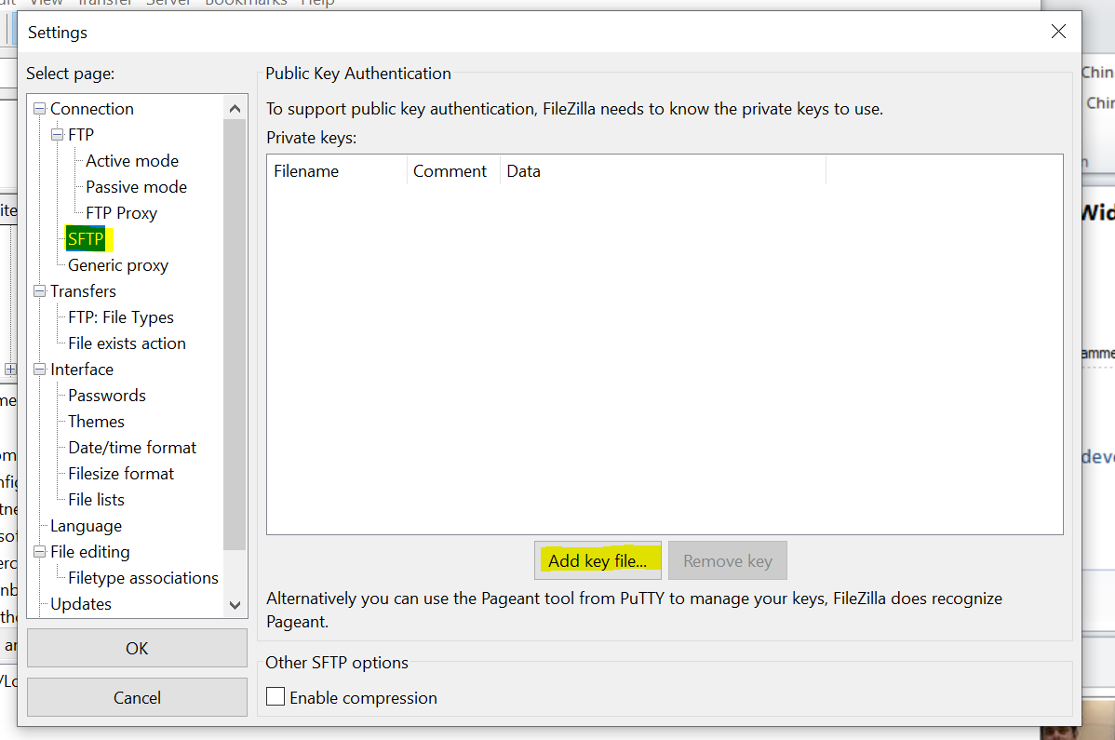
FTP Client Installation
https://filezilla-project.org/download.php?platform=osx

Slide 33
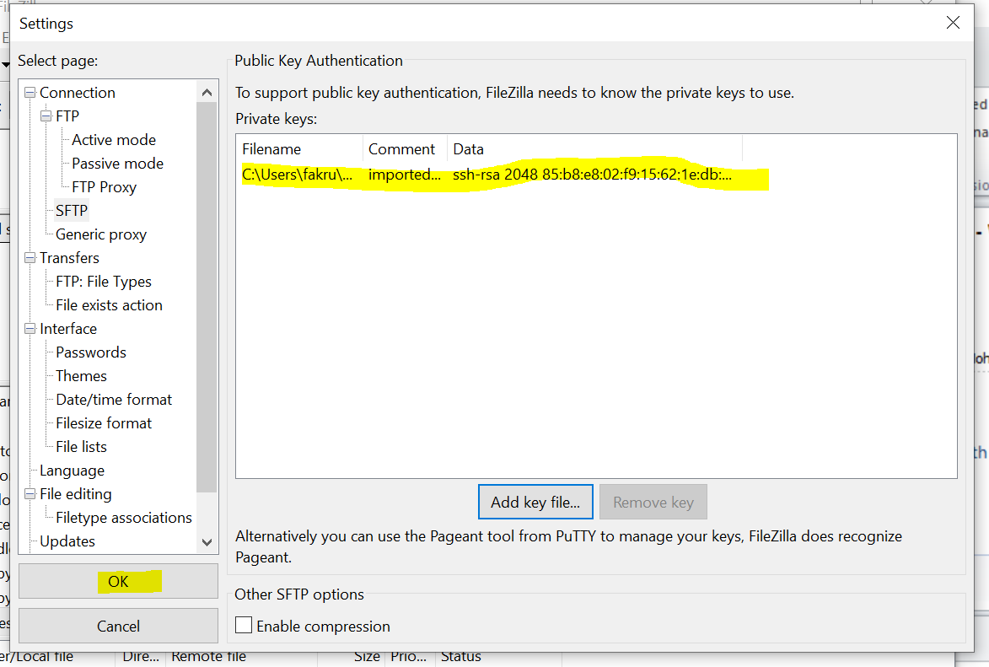
FTP Client Installation
https://filezilla-project.org/download.php?platform=osx

Slide 34
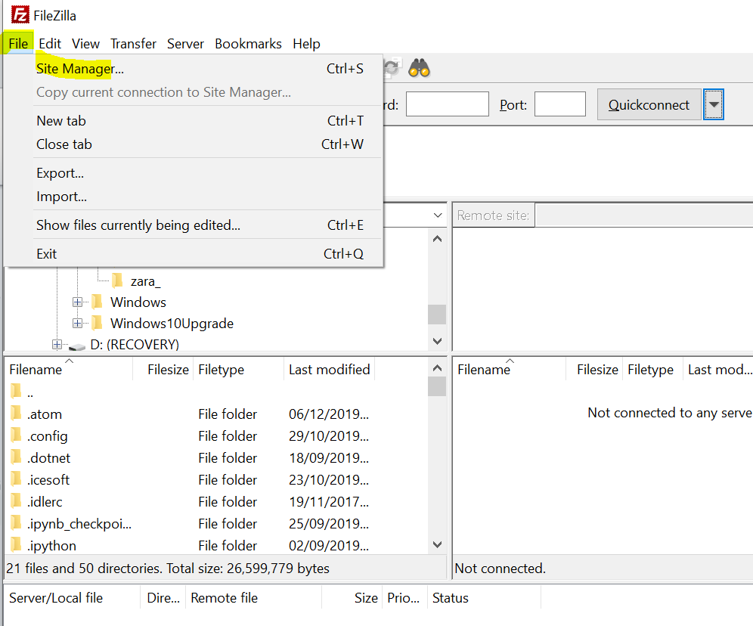
FTP Client Installation
https://filezilla-project.org/download.php?platform=osx

Slide 35
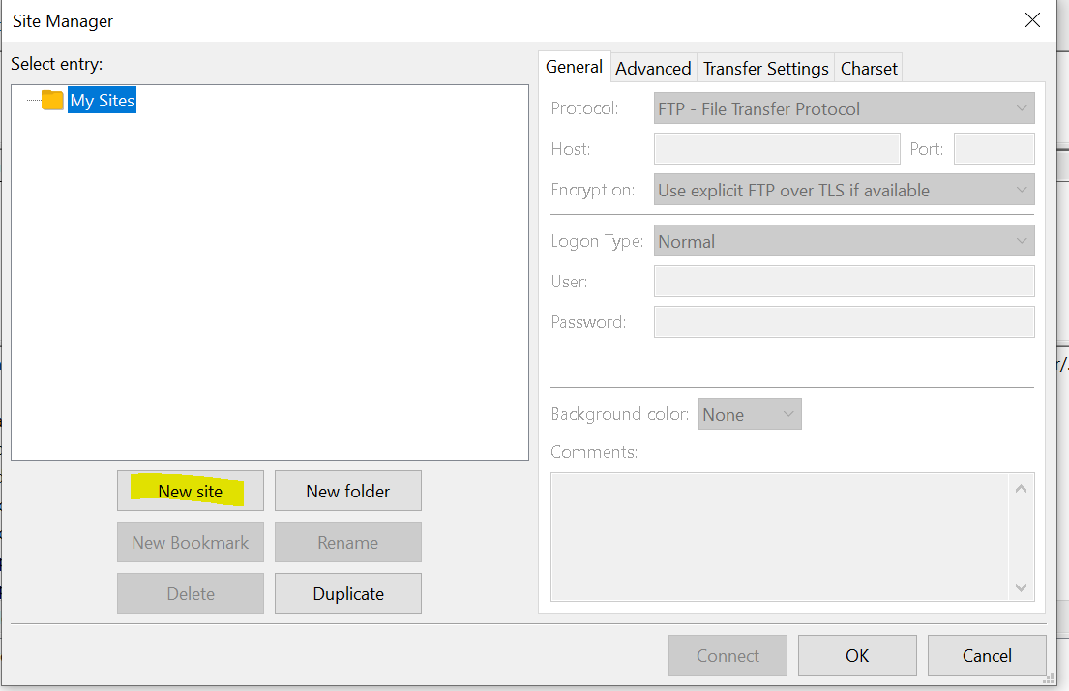
FTP Client Installation
https://filezilla-project.org/download.php?platform=osx

Slide 36
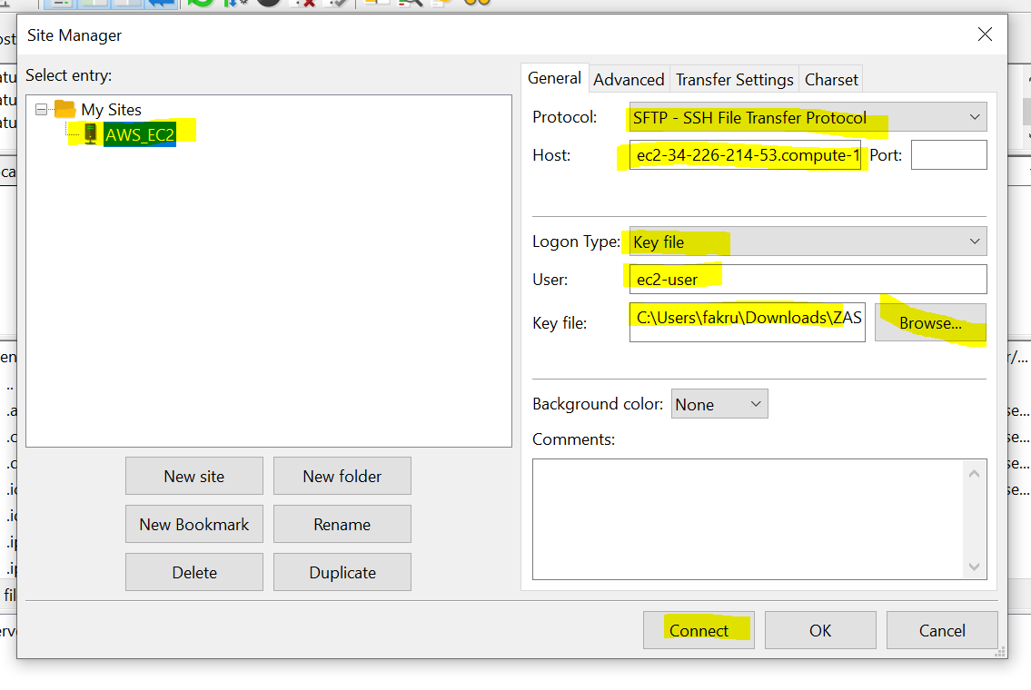
FTP Client Installation
https://filezilla-project.org/download.php?platform=osx

Slide 37
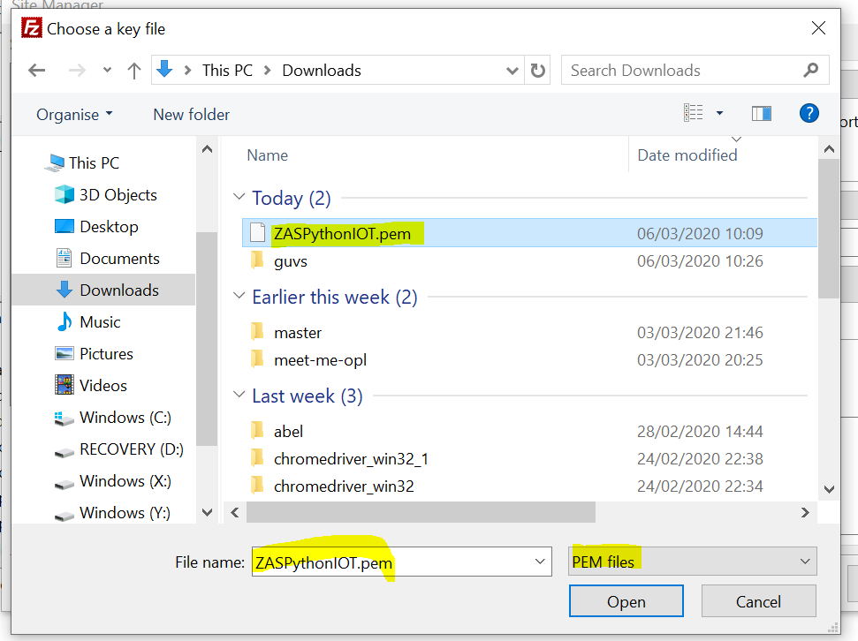
FTP Client Installation
https://filezilla-project.org/download.php?platform=osx

Slide 38
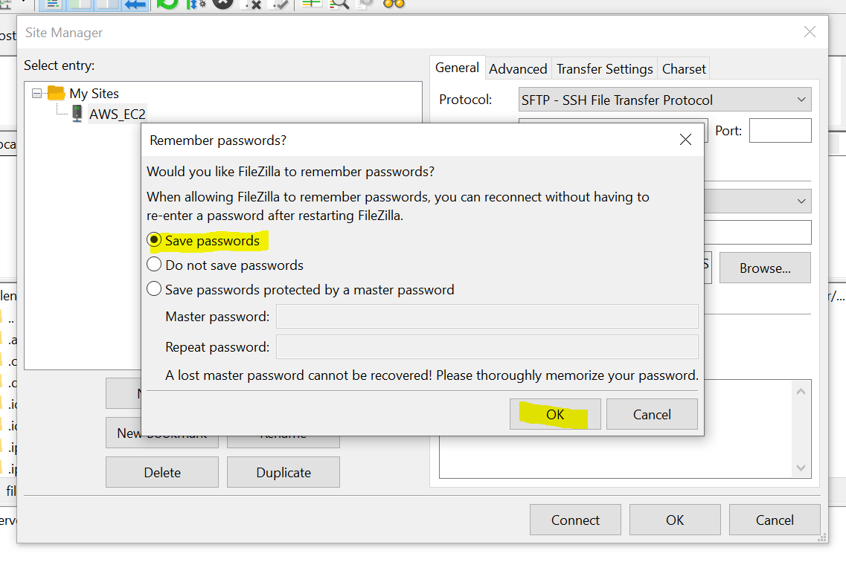
FTP Client Installation
https://filezilla-project.org/download.php?platform=osx

Slide 39
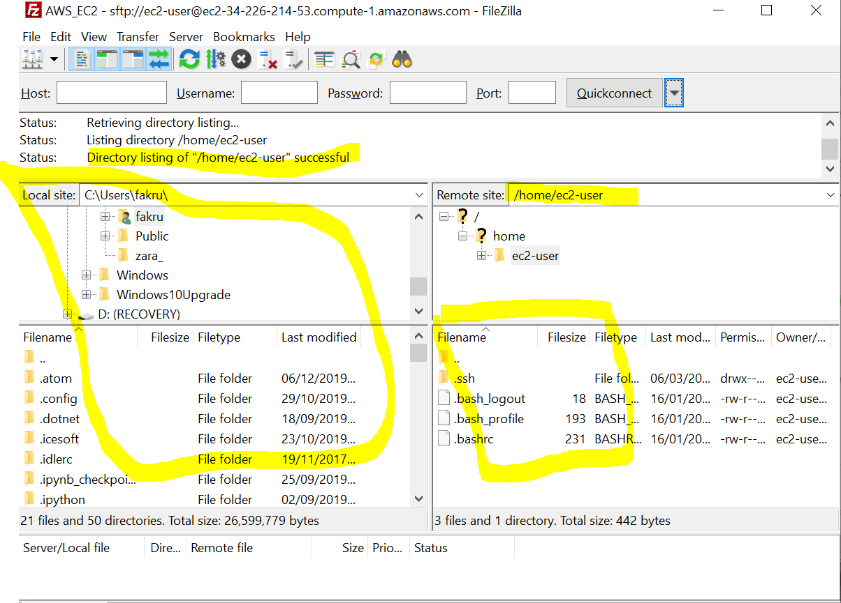
FTP Client Installation
https://filezilla-project.org/download.php?platform=osx

Slide 41
Appendix

Slide 42
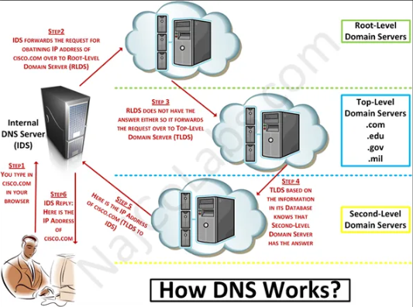
Cloud Computing at Home

